Slide 1
Introduction of CICD

Slide 2
DevOps Pipeline / Cycle
Source Code Management and GitFlow
Introduction of Jenkins
Introduction of SonarQube

Slide 3
DevOps Pipeline / Cycle

Slide 4
What is Continuous Integration?
A practice where developers integrate code into a shared repository frequently
Each integration can then be verified by an automated build and automated tests
Additionally having other integrated tools for quality and security are important as well
Notes:
Continuous Integration (CI) is the process of automating the build and testing of code every time a team member commits changes to version control.
Key points
It’s A practice that encourages developers to integrate code into a repository frequently. Each check-in is then verified by an automated building and testing process..
It is the concept of frequently building and testing code to merge changes and find problems as quickly as possible rather than waiting for a scheduled deployment.
Enterprise scale applications are usually developed in modules and having different versions/features development running in parallel. CI enables teams to find out potential defects and fix it immediately.
Additionally, QA tools like static code analysis (SonarQube) are usually integrated into the pipeline to ensure the quality and stability of the product.

Slide 5
What is Continuous Delivery?
The practice of keeping your codebase deployable at any point
Perform push-button deployments of any version of the software to any environment on demand
Beyond making sure your application passes automated tests it has to have all the configuration necessary to push it into any environment
Notes:
Extending CI process, to include more tests and deploy phases, Continuous Delivery is the practice to keep the applications deployable to any environment (from UAT, SIT to Production) at any point.
It reduces the overhead of manually deploying whenever there’s any changes, fixes or updates.
Through established CD pipelines, procedures like production check, security scan, and cross team communication & notification can be automated by the system.

Slide 6
What are the benefits?
Build stuff now, faster and make it repeatable
Consistent
Quality Software
Early detection
Deploy even to production!
Notes:
The are many benefits coming with CI and CD, for instances:
1.It minimised the risk - by finding problems quickly the developers can fix the problems at a quicker rate
2. Faster time to market. It’s not uncommon for the integration and test/fix phase of the traditional phased software delivery lifecycle to consume weeks or even months. When teams work together to automate the build and deployment, environment provisioning, and regression testing processes, developers can incorporate integration and regression testing into their daily work and completely remove these phases. We also avoid the large amounts of re-work that plague the phased approach.
3. Higher quality. When developers have automated tools that discover regressions within minutes, teams are freed to focus their effort on user research and higher level testing activities such as exploratory testing, usability testing, and performance and security testing. By building CI and CD pipelines, these activities can be performed continuously throughout the delivery process, ensuring quality is built in to products and services from the beginning.
4.Fosters transparency and confidence - Development teams, business stakeholders, project teams can check the product and project status at any time. Furthermore, By removing the low-value painful activities associated with software delivery, software delivery teams can engage more actively with users, and have a quicker learning cycle.

Slide 7
“Continuous Integration doesn’t get rid of bugs, but it does make them dramatically easier to find and remove.” — Martin Fowler, Chief Scientist, ThoughtWorks
Notes:
In short, we’re not trying to create a bug-free environment, instead we embrace them and trying to establish a way that we can find and fix them in a timely manner.

Slide 8
Standard CI CD Pipeline
 | Java/Maven CI Pipeline | XCode CI Pipeline
Read Configuration | Read properties file | Read properties file
Init |  | xcode-select pod install
Resolve Dependencies and Build | Artifactory Plugin Maven Build | xcodebuild
Unit Test | Mvn test | xcodebuild test
Package and Store | mvn install | xcodebuild clean archive
Update JIRA | Build status | Build status
Code Quality | mvn sonar:sonar | Sonarqube-scanner
Open-Source Governance | Black Duck | Black Duck
Code Security Scanning | Fortify | Fortify
Notifications | Email Slack | Email Slack
Provide a common practice to standardize and automate the development process
Automates build tasks, and enforce unit test, code quality, security scan and E2E test
Production release management is not supported currently in the pipeline. Semi-Auto process is in place
Notes:
A standard CI Pipeline provides a common practice to standardize and automate the building, testing and scanning process.
Taking Java and Xcode Pipeline as examples, the pipelines cover from reading apps and environment configuration, tools initialisation, app build. Unit testing, packaging, JIRA update, code quality control, libraries scanning, security scanning to notification.

Slide 9
Standard CI, Deployment and Testing Pipelines – Building Blocks
Notes:
There can be many pipelines for different projects.
While different types of project may have different testing requirements, building steps & script, and deployment procedures, pipelines can be customised and set to fit the project needs. Taking the diagram as an example, different project pipelines can be set to use different building blocks (process) , and different project can use the same building block (process).

Slide 10
Source Code Management and GitFlow

Slide 11
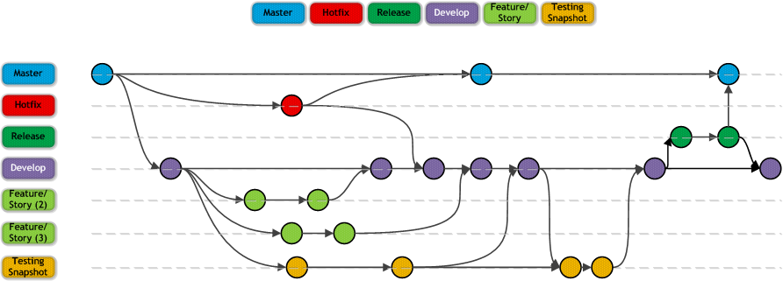
What is GitFlow?
Master - Production
Hotfix - Fire Flight
Release - Staging/Simulation
Develop - Development Main Branch
Feature - Story, Function..
Testing Snapshot – UAT
Notes:
Git is the most common source control management (SCM) to manage the codes, we use GIT and follows branching strategies to let the developers have a unified development workflow.
Our model has six types of branches: Master, Hotfix, Release, Develop, Feature and Testing.
Master and Develop branches are the two main branches to record the history of the product.
Master branch
– Master branch is where we release code into Production
– Each commit on the master branch should be tagged
Develop Branch
– develop branch is used for integration
– develop branch is deployed to Dev and Test environments as part of development and testing processes
– develop branch is read-only for most team members; only leads should be able to merge to this branch
Feature Branch, where all development effort and most break-fix occurs
– New features are created on Feature branches that branch from develop
– Feature branches can incorporate new functionality (User Stories) or defect fixes (Bugs)
– Feature branches should merge changes from develop at least daily to minimize merge challenges
– Once the feature is complete, the branch is merged to develop
– Feature branches can be deleted after the final merge to develop
Release Branch is used to stabilise a release and allow continued development
– Created as the release date is approaching
– No new features are allowed on the release branch; only bug fixes, documentation generation, etc.
– Once ready to ship, the release branch is merged into master, tagged with a version number, and merged back into develop
– In some cases, release branches may not be used for MVP release to simplify the approach and minimize the need for additional environments.
Hotfixe Branch is typically used for “emergency” changes to Production
– Used to quickly patch production
– When the fix is complete and tested, the branch should be merged into master and tagged, and then merged into develop
Testing Snapshot Branch is used for testing
– Created for testing like UAT
– It’s a snapshot and shippable version of a product, which is freeze until the testing is completed

Slide 12
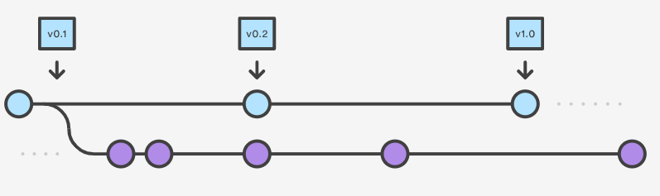
What is GitFlow?
Develop and Master Branches
The master branch stores the official release history, and the develop branch serves as an integration branch for features. It’s so convenient to tag all commits in the master branch with a version number
Notes:
Git is the most common source control management (SCM) to manage the codes, we use GIT and follows branching strategies to let the developers have a unified development workflow.
Our model has six types of branches: Master, Hotfix, Release, Develop, Feature and Testing.
Master and Develop branches are the two main branches to record the history of the product.
Master branch
– Master branch is where we release code into Production
– Each commit on the master branch should be tagged
Develop Branch
– develop branch is used for integration
– develop branch is deployed to Dev and Test environments as part of development and testing processes
– develop branch is read-only for most team members; only leads should be able to merge to this branch
Feature Branch, where all development effort and most break-fix occurs
– New features are created on Feature branches that branch from develop
– Feature branches can incorporate new functionality (User Stories) or defect fixes (Bugs)
– Feature branches should merge changes from develop at least daily to minimize merge challenges
– Once the feature is complete, the branch is merged to develop
– Feature branches can be deleted after the final merge to develop
Release Branch is used to stabilise a release and allow continued development
– Created as the release date is approaching
– No new features are allowed on the release branch; only bug fixes, documentation generation, etc.
– Once ready to ship, the release branch is merged into master, tagged with a version number, and merged back into develop
– In some cases, release branches may not be used for MVP release to simplify the approach and minimize the need for additional environments.
Hotfixe Branch is typically used for “emergency” changes to Production
– Used to quickly patch production
– When the fix is complete and tested, the branch should be merged into master and tagged, and then merged into develop
Testing Snapshot Branch is used for testing
– Created for testing like UAT
– It’s a snapshot and shippable version of a product, which is freeze until the testing is completed

Slide 13
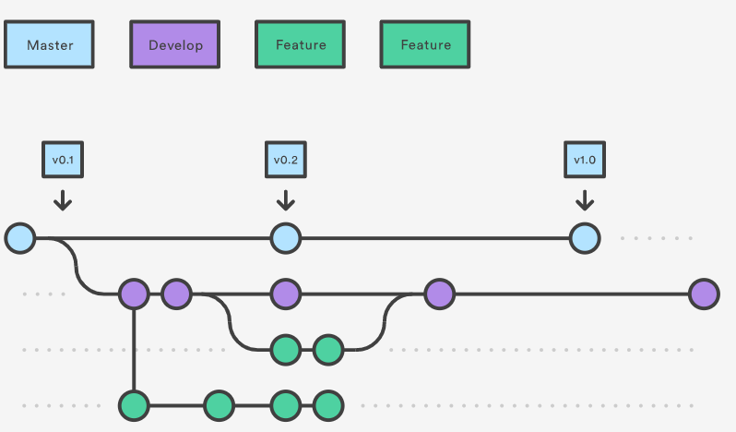
What is GitFlow?
Feature Branches
Each new feature should reside in its own branch, which can be pushed to the central repository for backup /collaboration. Feature branches use develop as their parent branch. We a feature is complete, it get merged back into develop. Feature should never interact directly with master
Notes:
Git is the most common source control management (SCM) to manage the codes, we use GIT and follows branching strategies to let the developers have a unified development workflow.
Our model has six types of branches: Master, Hotfix, Release, Develop, Feature and Testing.
Master and Develop branches are the two main branches to record the history of the product.
Master branch
– Master branch is where we release code into Production
– Each commit on the master branch should be tagged
Develop Branch
– develop branch is used for integration
– develop branch is deployed to Dev and Test environments as part of development and testing processes
– develop branch is read-only for most team members; only leads should be able to merge to this branch
Feature Branch, where all development effort and most break-fix occurs
– New features are created on Feature branches that branch from develop
– Feature branches can incorporate new functionality (User Stories) or defect fixes (Bugs)
– Feature branches should merge changes from develop at least daily to minimize merge challenges
– Once the feature is complete, the branch is merged to develop
– Feature branches can be deleted after the final merge to develop
Release Branch is used to stabilise a release and allow continued development
– Created as the release date is approaching
– No new features are allowed on the release branch; only bug fixes, documentation generation, etc.
– Once ready to ship, the release branch is merged into master, tagged with a version number, and merged back into develop
– In some cases, release branches may not be used for MVP release to simplify the approach and minimize the need for additional environments.
Hotfixe Branch is typically used for “emergency” changes to Production
– Used to quickly patch production
– When the fix is complete and tested, the branch should be merged into master and tagged, and then merged into develop
Testing Snapshot Branch is used for testing
– Created for testing like UAT
– It’s a snapshot and shippable version of a product, which is freeze until the testing is completed

Slide 14
What is GitFlow?
Feature Branches
Clone the repository to local
git clone <repository url>
Creating a feature branch
git checkout develop
git checkout –b feature_branch
Now, you can start your development under the new feature branch
Notes:
Git is the most common source control management (SCM) to manage the codes, we use GIT and follows branching strategies to let the developers have a unified development workflow.
Our model has six types of branches: Master, Hotfix, Release, Develop, Feature and Testing.
Master and Develop branches are the two main branches to record the history of the product.
Master branch
– Master branch is where we release code into Production
– Each commit on the master branch should be tagged
Develop Branch
– develop branch is used for integration
– develop branch is deployed to Dev and Test environments as part of development and testing processes
– develop branch is read-only for most team members; only leads should be able to merge to this branch
Feature Branch, where all development effort and most break-fix occurs
– New features are created on Feature branches that branch from develop
– Feature branches can incorporate new functionality (User Stories) or defect fixes (Bugs)
– Feature branches should merge changes from develop at least daily to minimize merge challenges
– Once the feature is complete, the branch is merged to develop
– Feature branches can be deleted after the final merge to develop
Release Branch is used to stabilise a release and allow continued development
– Created as the release date is approaching
– No new features are allowed on the release branch; only bug fixes, documentation generation, etc.
– Once ready to ship, the release branch is merged into master, tagged with a version number, and merged back into develop
– In some cases, release branches may not be used for MVP release to simplify the approach and minimize the need for additional environments.
Hotfixe Branch is typically used for “emergency” changes to Production
– Used to quickly patch production
– When the fix is complete and tested, the branch should be merged into master and tagged, and then merged into develop
Testing Snapshot Branch is used for testing
– Created for testing like UAT
– It’s a snapshot and shippable version of a product, which is freeze until the testing is completed

Slide 15
What is GitFlow?
Daily work for a developer
Switch branch
Git checkout <branch-name>
Pull the code from central repository
Git pull
Start development
Notes:
Git is the most common source control management (SCM) to manage the codes, we use GIT and follows branching strategies to let the developers have a unified development workflow.
Our model has six types of branches: Master, Hotfix, Release, Develop, Feature and Testing.
Master and Develop branches are the two main branches to record the history of the product.
Master branch
– Master branch is where we release code into Production
– Each commit on the master branch should be tagged
Develop Branch
– develop branch is used for integration
– develop branch is deployed to Dev and Test environments as part of development and testing processes
– develop branch is read-only for most team members; only leads should be able to merge to this branch
Feature Branch, where all development effort and most break-fix occurs
– New features are created on Feature branches that branch from develop
– Feature branches can incorporate new functionality (User Stories) or defect fixes (Bugs)
– Feature branches should merge changes from develop at least daily to minimize merge challenges
– Once the feature is complete, the branch is merged to develop
– Feature branches can be deleted after the final merge to develop
Release Branch is used to stabilise a release and allow continued development
– Created as the release date is approaching
– No new features are allowed on the release branch; only bug fixes, documentation generation, etc.
– Once ready to ship, the release branch is merged into master, tagged with a version number, and merged back into develop
– In some cases, release branches may not be used for MVP release to simplify the approach and minimize the need for additional environments.
Hotfixe Branch is typically used for “emergency” changes to Production
– Used to quickly patch production
– When the fix is complete and tested, the branch should be merged into master and tagged, and then merged into develop
Testing Snapshot Branch is used for testing
– Created for testing like UAT
– It’s a snapshot and shippable version of a product, which is freeze until the testing is completed

Slide 16
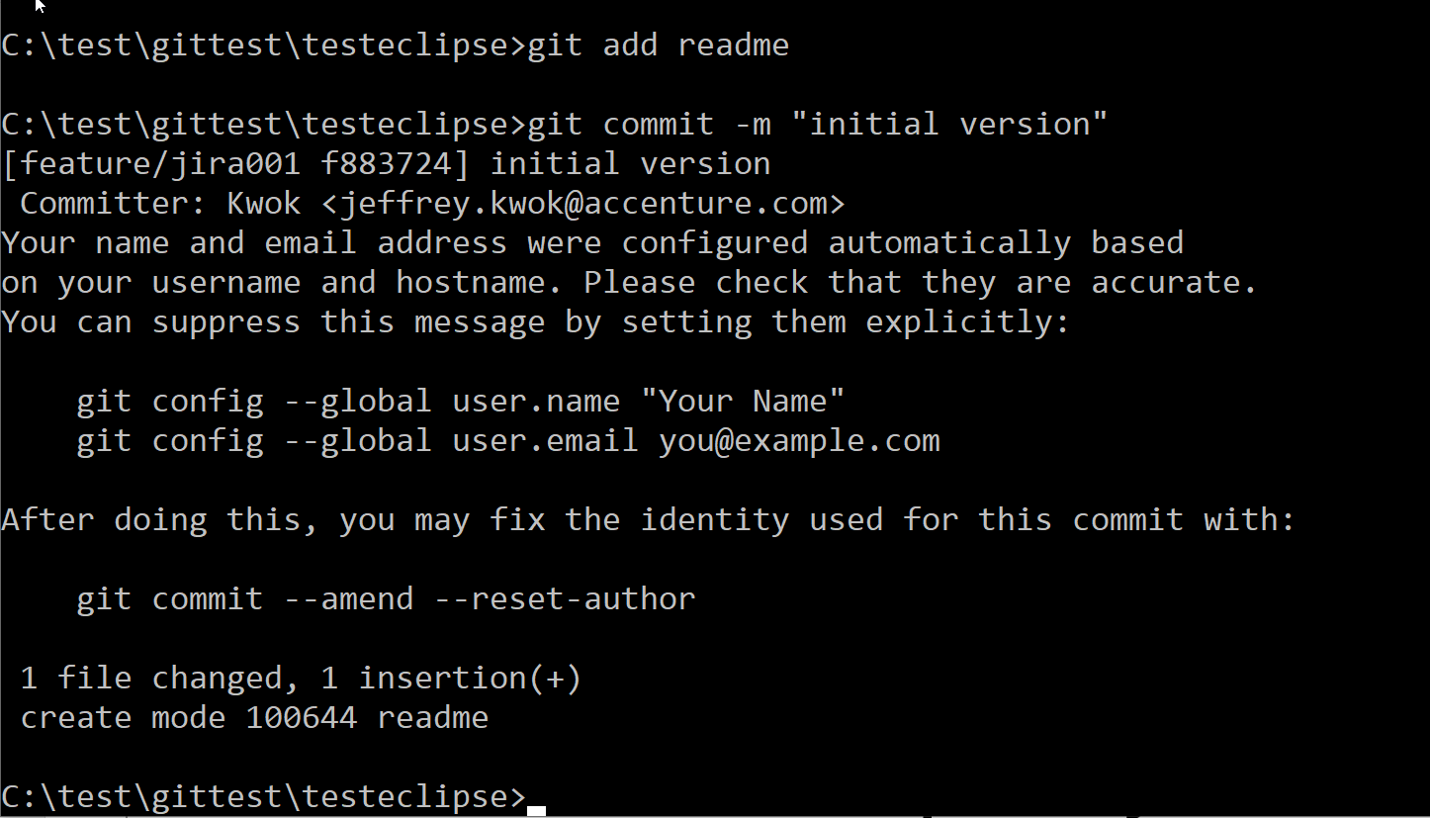
What is GitFlow?
Daily work for a developer
Commit the code to local repository
Git add <file>
Git commit –m “Initial version”
Notes:
Git is the most common source control management (SCM) to manage the codes, we use GIT and follows branching strategies to let the developers have a unified development workflow.
Our model has six types of branches: Master, Hotfix, Release, Develop, Feature and Testing.
Master and Develop branches are the two main branches to record the history of the product.
Master branch
– Master branch is where we release code into Production
– Each commit on the master branch should be tagged
Develop Branch
– develop branch is used for integration
– develop branch is deployed to Dev and Test environments as part of development and testing processes
– develop branch is read-only for most team members; only leads should be able to merge to this branch
Feature Branch, where all development effort and most break-fix occurs
– New features are created on Feature branches that branch from develop
– Feature branches can incorporate new functionality (User Stories) or defect fixes (Bugs)
– Feature branches should merge changes from develop at least daily to minimize merge challenges
– Once the feature is complete, the branch is merged to develop
– Feature branches can be deleted after the final merge to develop
Release Branch is used to stabilise a release and allow continued development
– Created as the release date is approaching
– No new features are allowed on the release branch; only bug fixes, documentation generation, etc.
– Once ready to ship, the release branch is merged into master, tagged with a version number, and merged back into develop
– In some cases, release branches may not be used for MVP release to simplify the approach and minimize the need for additional environments.
Hotfixe Branch is typically used for “emergency” changes to Production
– Used to quickly patch production
– When the fix is complete and tested, the branch should be merged into master and tagged, and then merged into develop
Testing Snapshot Branch is used for testing
– Created for testing like UAT
– It’s a snapshot and shippable version of a product, which is freeze until the testing is completed

Slide 17
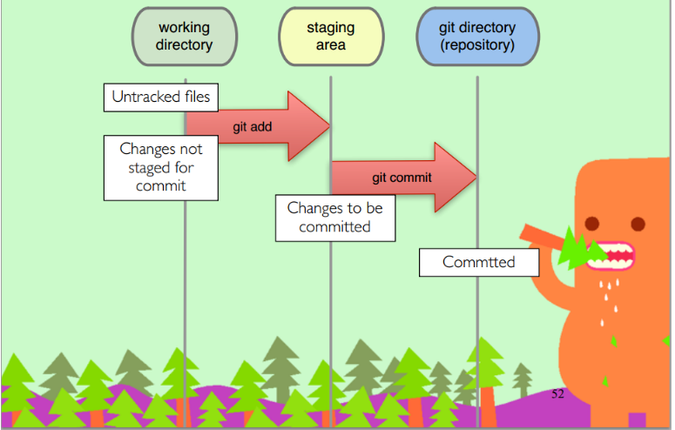
What is GitFlow?
Daily work for a developer
Commit the code to local repository
Git add <file>
Git commit –m “Initial version”
Notes:
Git is the most common source control management (SCM) to manage the codes, we use GIT and follows branching strategies to let the developers have a unified development workflow.
Our model has six types of branches: Master, Hotfix, Release, Develop, Feature and Testing.
Master and Develop branches are the two main branches to record the history of the product.
Master branch
– Master branch is where we release code into Production
– Each commit on the master branch should be tagged
Develop Branch
– develop branch is used for integration
– develop branch is deployed to Dev and Test environments as part of development and testing processes
– develop branch is read-only for most team members; only leads should be able to merge to this branch
Feature Branch, where all development effort and most break-fix occurs
– New features are created on Feature branches that branch from develop
– Feature branches can incorporate new functionality (User Stories) or defect fixes (Bugs)
– Feature branches should merge changes from develop at least daily to minimize merge challenges
– Once the feature is complete, the branch is merged to develop
– Feature branches can be deleted after the final merge to develop
Release Branch is used to stabilise a release and allow continued development
– Created as the release date is approaching
– No new features are allowed on the release branch; only bug fixes, documentation generation, etc.
– Once ready to ship, the release branch is merged into master, tagged with a version number, and merged back into develop
– In some cases, release branches may not be used for MVP release to simplify the approach and minimize the need for additional environments.
Hotfixe Branch is typically used for “emergency” changes to Production
– Used to quickly patch production
– When the fix is complete and tested, the branch should be merged into master and tagged, and then merged into develop
Testing Snapshot Branch is used for testing
– Created for testing like UAT
– It’s a snapshot and shippable version of a product, which is freeze until the testing is completed

Slide 18
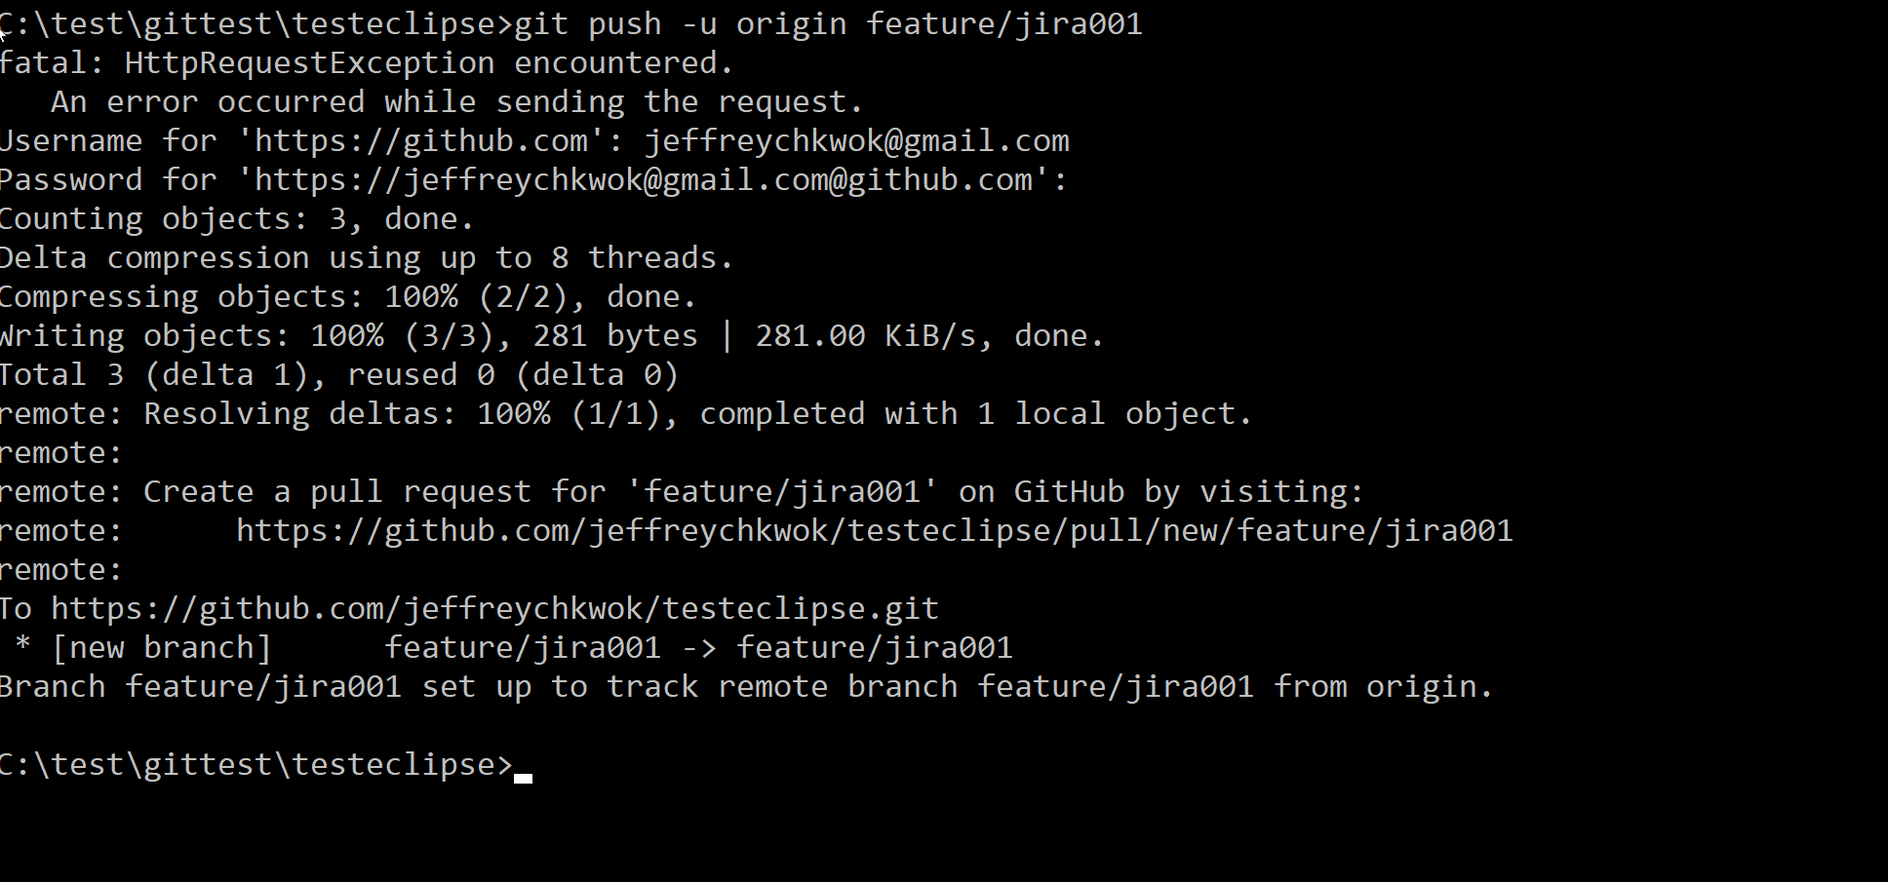
What is GitFlow?
Daily work for a developer
Push the committed changes to central repository
Git push –u origin <remote branch name>
Resolve code conflict
Team members may working on the same file which conflicts may occurs. Developers should resolve it before commit and push
Notes:
Git is the most common source control management (SCM) to manage the codes, we use GIT and follows branching strategies to let the developers have a unified development workflow.
Our model has six types of branches: Master, Hotfix, Release, Develop, Feature and Testing.
Master and Develop branches are the two main branches to record the history of the product.
Master branch
– Master branch is where we release code into Production
– Each commit on the master branch should be tagged
Develop Branch
– develop branch is used for integration
– develop branch is deployed to Dev and Test environments as part of development and testing processes
– develop branch is read-only for most team members; only leads should be able to merge to this branch
Feature Branch, where all development effort and most break-fix occurs
– New features are created on Feature branches that branch from develop
– Feature branches can incorporate new functionality (User Stories) or defect fixes (Bugs)
– Feature branches should merge changes from develop at least daily to minimize merge challenges
– Once the feature is complete, the branch is merged to develop
– Feature branches can be deleted after the final merge to develop
Release Branch is used to stabilise a release and allow continued development
– Created as the release date is approaching
– No new features are allowed on the release branch; only bug fixes, documentation generation, etc.
– Once ready to ship, the release branch is merged into master, tagged with a version number, and merged back into develop
– In some cases, release branches may not be used for MVP release to simplify the approach and minimize the need for additional environments.
Hotfixe Branch is typically used for “emergency” changes to Production
– Used to quickly patch production
– When the fix is complete and tested, the branch should be merged into master and tagged, and then merged into develop
Testing Snapshot Branch is used for testing
– Created for testing like UAT
– It’s a snapshot and shippable version of a product, which is freeze until the testing is completed

Slide 19
What is GitFlow?
Feature Branches
Finish a feature branch
When you’re done with the development work on the feature, the next step is to merge the feature branch into develop
Before merge, you needed to notify your team members through Pull Request
Notes:
Git is the most common source control management (SCM) to manage the codes, we use GIT and follows branching strategies to let the developers have a unified development workflow.
Our model has six types of branches: Master, Hotfix, Release, Develop, Feature and Testing.
Master and Develop branches are the two main branches to record the history of the product.
Master branch
– Master branch is where we release code into Production
– Each commit on the master branch should be tagged
Develop Branch
– develop branch is used for integration
– develop branch is deployed to Dev and Test environments as part of development and testing processes
– develop branch is read-only for most team members; only leads should be able to merge to this branch
Feature Branch, where all development effort and most break-fix occurs
– New features are created on Feature branches that branch from develop
– Feature branches can incorporate new functionality (User Stories) or defect fixes (Bugs)
– Feature branches should merge changes from develop at least daily to minimize merge challenges
– Once the feature is complete, the branch is merged to develop
– Feature branches can be deleted after the final merge to develop
Release Branch is used to stabilise a release and allow continued development
– Created as the release date is approaching
– No new features are allowed on the release branch; only bug fixes, documentation generation, etc.
– Once ready to ship, the release branch is merged into master, tagged with a version number, and merged back into develop
– In some cases, release branches may not be used for MVP release to simplify the approach and minimize the need for additional environments.
Hotfixe Branch is typically used for “emergency” changes to Production
– Used to quickly patch production
– When the fix is complete and tested, the branch should be merged into master and tagged, and then merged into develop
Testing Snapshot Branch is used for testing
– Created for testing like UAT
– It’s a snapshot and shippable version of a product, which is freeze until the testing is completed

Slide 20
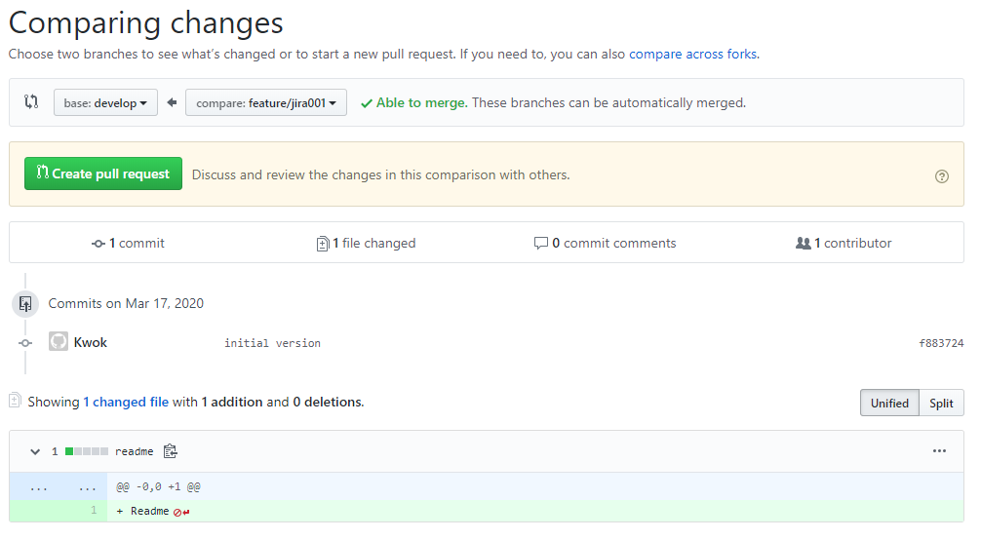
What is GitFlow?
Push Request
Raise a Push Request
Pull request are a mechanism for a developer to notify team members that they have completed a feature. Once their feature branch is ready, the developer files a pull request via their account. This lets everybody involved know that they need to review the code and merge it into the master branch

Slide 21
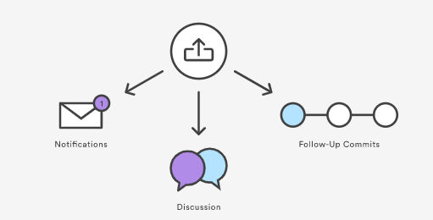
What is GitFlow?
Push Request
But, the pull request is more than just a notification. If there are any problems with the changes, teammates can post feedback in the pull request and even tweak the feature by pushing follow-up commits. All of this activity is tracked directly inside of the pull request.

Slide 22
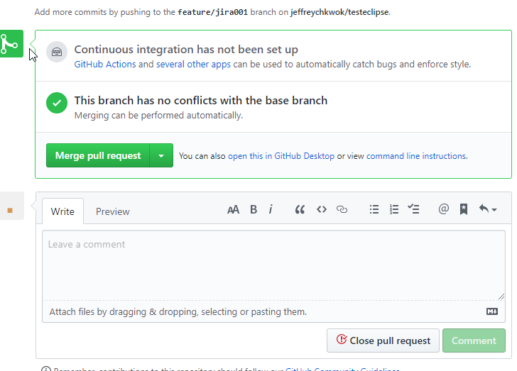
What is GitFlow?
Push Request
After team discussion and reviewed the code, project maintainer can merges the feature into the official repository and close the pull request.

Slide 23
What is GitFlow?
Release Branches
Created as the release date is approaching
No new features are allowed on the release branch; only bug fixes, documentation generation, etc.
Once ready to ship, the release branch is merged into master, tagged with a version number, and merged back into develop
Notes:
Git is the most common source control management (SCM) to manage the codes, we use GIT and follows branching strategies to let the developers have a unified development workflow.
Our model has six types of branches: Master, Hotfix, Release, Develop, Feature and Testing.
Master and Develop branches are the two main branches to record the history of the product.
Master branch
– Master branch is where we release code into Production
– Each commit on the master branch should be tagged
Develop Branch
– develop branch is used for integration
– develop branch is deployed to Dev and Test environments as part of development and testing processes
– develop branch is read-only for most team members; only leads should be able to merge to this branch
Feature Branch, where all development effort and most break-fix occurs
– New features are created on Feature branches that branch from develop
– Feature branches can incorporate new functionality (User Stories) or defect fixes (Bugs)
– Feature branches should merge changes from develop at least daily to minimize merge challenges
– Once the feature is complete, the branch is merged to develop
– Feature branches can be deleted after the final merge to develop
Release Branch is used to stabilise a release and allow continued development
– Created as the release date is approaching
– No new features are allowed on the release branch; only bug fixes, documentation generation, etc.
– Once ready to ship, the release branch is merged into master, tagged with a version number, and merged back into develop
– In some cases, release branches may not be used for MVP release to simplify the approach and minimize the need for additional environments.
Hotfixe Branch is typically used for “emergency” changes to Production
– Used to quickly patch production
– When the fix is complete and tested, the branch should be merged into master and tagged, and then merged into develop
Testing Snapshot Branch is used for testing
– Created for testing like UAT
– It’s a snapshot and shippable version of a product, which is freeze until the testing is completed

Slide 24
What is GitFlow?
Hotfix Branches
Hotfix Branch is typically used for “emergency” changes to Production
Used to quickly patch production
When the fix is complete and tested, the branch should be merged into master and tagged, and then merged into develop
Notes:
Git is the most common source control management (SCM) to manage the codes, we use GIT and follows branching strategies to let the developers have a unified development workflow.
Our model has six types of branches: Master, Hotfix, Release, Develop, Feature and Testing.
Master and Develop branches are the two main branches to record the history of the product.
Master branch
– Master branch is where we release code into Production
– Each commit on the master branch should be tagged
Develop Branch
– develop branch is used for integration
– develop branch is deployed to Dev and Test environments as part of development and testing processes
– develop branch is read-only for most team members; only leads should be able to merge to this branch
Feature Branch, where all development effort and most break-fix occurs
– New features are created on Feature branches that branch from develop
– Feature branches can incorporate new functionality (User Stories) or defect fixes (Bugs)
– Feature branches should merge changes from develop at least daily to minimize merge challenges
– Once the feature is complete, the branch is merged to develop
– Feature branches can be deleted after the final merge to develop
Release Branch is used to stabilise a release and allow continued development
– Created as the release date is approaching
– No new features are allowed on the release branch; only bug fixes, documentation generation, etc.
– Once ready to ship, the release branch is merged into master, tagged with a version number, and merged back into develop
– In some cases, release branches may not be used for MVP release to simplify the approach and minimize the need for additional environments.
Hotfixe Branch is typically used for “emergency” changes to Production
– Used to quickly patch production
– When the fix is complete and tested, the branch should be merged into master and tagged, and then merged into develop
Testing Snapshot Branch is used for testing
– Created for testing like UAT
– It’s a snapshot and shippable version of a product, which is freeze until the testing is completed

Slide 25
What is GitFlow?
Overall flow of GitFlow
A develop branch is created from master
A release branch is created from develop
Feature branches are created from develop
When a feature is complete it is merged into the develop branch
When the release branch is done it is merged into develop and master
If an issue in master is detected a hotfix branch is created from master
Once the hotfix is complete it is merged to both develop and master
Notes:
Git is the most common source control management (SCM) to manage the codes, we use GIT and follows branching strategies to let the developers have a unified development workflow.
Our model has six types of branches: Master, Hotfix, Release, Develop, Feature and Testing.
Master and Develop branches are the two main branches to record the history of the product.
Master branch
– Master branch is where we release code into Production
– Each commit on the master branch should be tagged
Develop Branch
– develop branch is used for integration
– develop branch is deployed to Dev and Test environments as part of development and testing processes
– develop branch is read-only for most team members; only leads should be able to merge to this branch
Feature Branch, where all development effort and most break-fix occurs
– New features are created on Feature branches that branch from develop
– Feature branches can incorporate new functionality (User Stories) or defect fixes (Bugs)
– Feature branches should merge changes from develop at least daily to minimize merge challenges
– Once the feature is complete, the branch is merged to develop
– Feature branches can be deleted after the final merge to develop
Release Branch is used to stabilise a release and allow continued development
– Created as the release date is approaching
– No new features are allowed on the release branch; only bug fixes, documentation generation, etc.
– Once ready to ship, the release branch is merged into master, tagged with a version number, and merged back into develop
– In some cases, release branches may not be used for MVP release to simplify the approach and minimize the need for additional environments.
Hotfixe Branch is typically used for “emergency” changes to Production
– Used to quickly patch production
– When the fix is complete and tested, the branch should be merged into master and tagged, and then merged into develop
Testing Snapshot Branch is used for testing
– Created for testing like UAT
– It’s a snapshot and shippable version of a product, which is freeze until the testing is completed

Slide 26
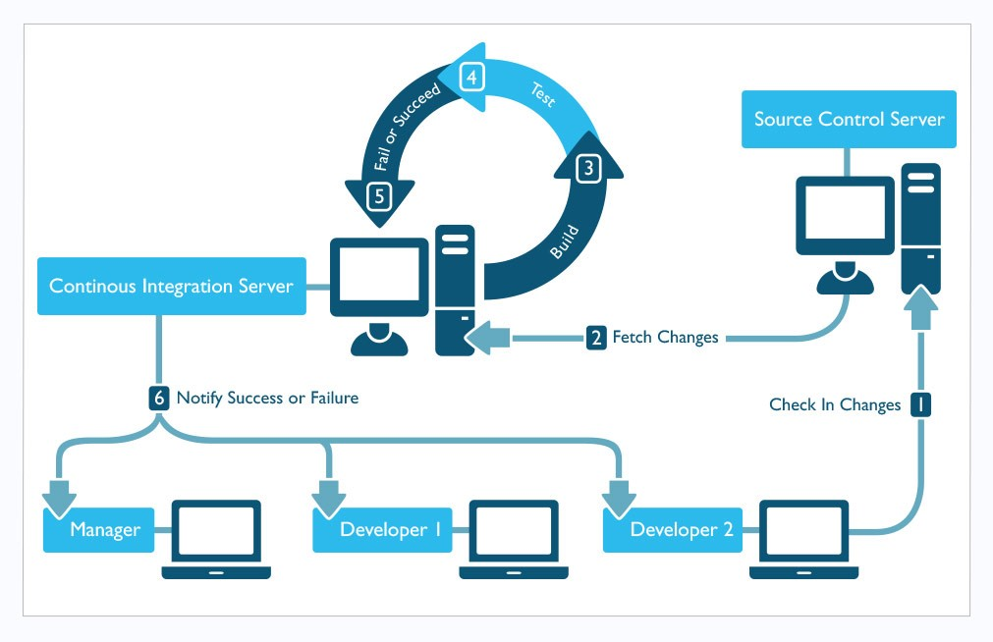
Overall Process
Notes:
In a CI lifecycle:
A developer commits his codes to the Source control
CI system fetches the changes and starts the integrate, build and test process
Results are recorded send to the team or any tracking systems.
Usually this cycle will be run through few times a day depending on situation.

Slide 27
Practical steps to use Git
1. Clone repository from Git
git clone <url>
2. Create a new branch and check out
git checkout -b <my branch name>
3. Add file to staging environment (ready to commit)
git add

Slide 28
Practical steps to use Git
4. Create the commit
git commit -m "Your message about the commit“
5. Push to repository
git push origin <my branch name>
6. Update branches from central repository
git fetch
6. Create Pull Request to merge into upper branches e.g. develop, release
**Note: Beware to clear all merge conflicts before asking for approval

Slide 29
BITBUCKET

Slide 30

OVERVIEW
BitBucket
A Git based code hosting and collaboration tool, built for teams.
It enables users to code, manage, and collaborate on Git projects.
Notes:
Bitbucket's best-in-class Jira and Trello integrations are designed to bring the entire software team together to execute on a project.
It provides one place for your team to collaborate on code from concept to Cloud, build quality code through automated testing, and deploy code with confidence.
A web-based hosting solution for projects that use either the Mercurial or Git revision control systems.
Provides unlimited private and public repositories.
The need of online collaborative work:
Track your change sets, monitor your source code edits, and drill through to your source files.
It’s worth having a back-up.
The quicker you make your code publicly available, the quicker you gain feedback and people to help you.
Getting feedback of users and interested developers who might want to join your team, provide helpful idea and move this project forward.

Slide 31
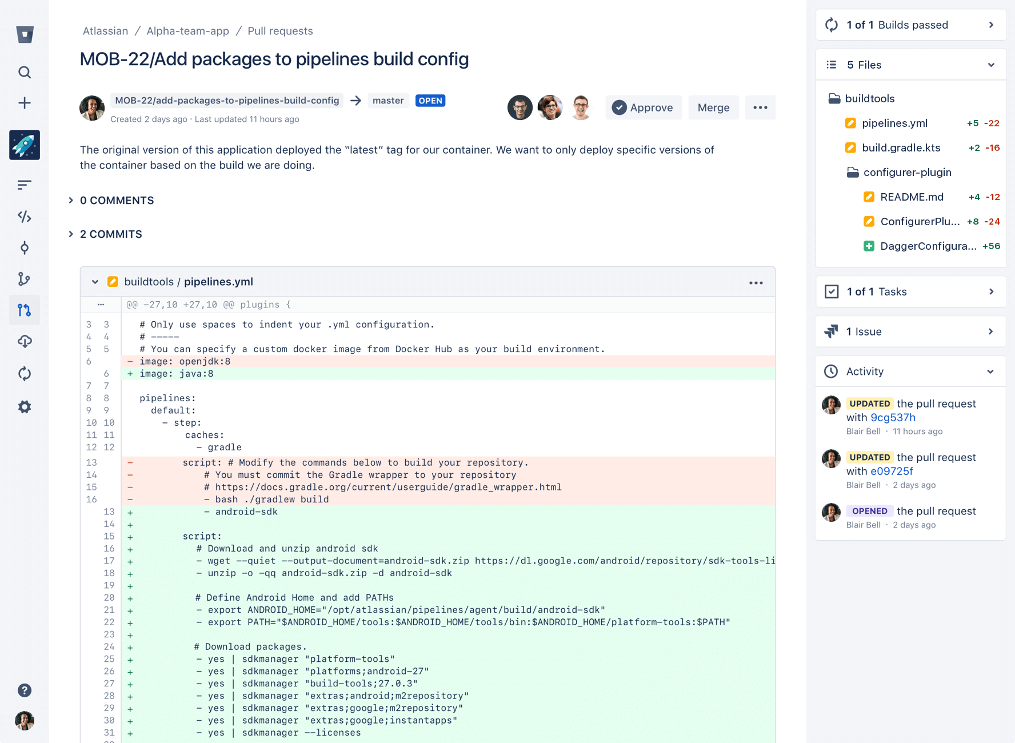
FEATURES
Code Review
Notes:
Continuously collaborate, merge with confidence, and deliver quality code.

Slide 32
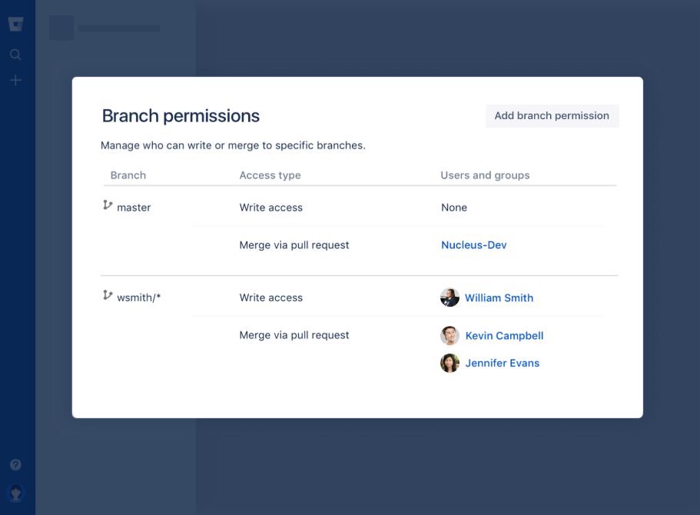
FEATURES
Branch Permissions
Notes:
Provide granular access control for your team, ensuring the right people have the right access to your code.

Slide 33
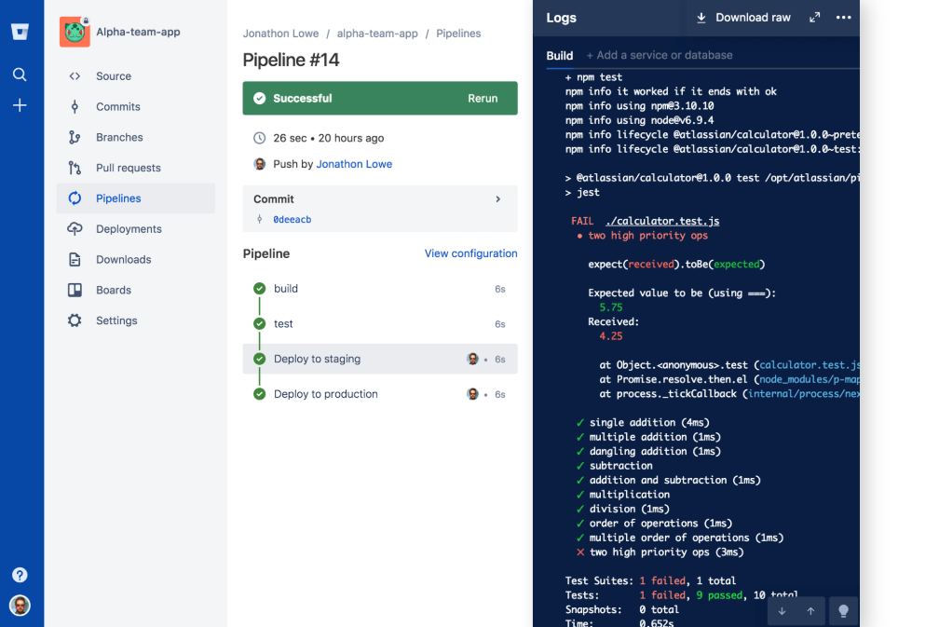
FEATURES
Pipelines
Notes:
Bitbucket’s integrated CI/CD tool that enables you to build and test automatically and deploy with confidence.

Slide 34

FEATURES
Plan
JIRA Software Integration
Trello Boards
Notes:
Jira Software integration - Create a branch from within a Jira Software issue and set up triggers to transition between statuses when reviewing or merging code.
Trello boards - Organize your projects and collaborate with your team on boards.

Slide 35

FEATURES
Collaborate
Diff Views
Projects
IDE Integrations
Notes:
Diff views - Understand what's changing in your repositories with unified or side-by-side diffs when reviewing code.
Projects - Help your team focus on a goal, product, or process by organizing your repositories into projects.
IDE integrations - Create and review Bitbucket pull requests, build and deploy, and more from within the IDE.

Slide 36
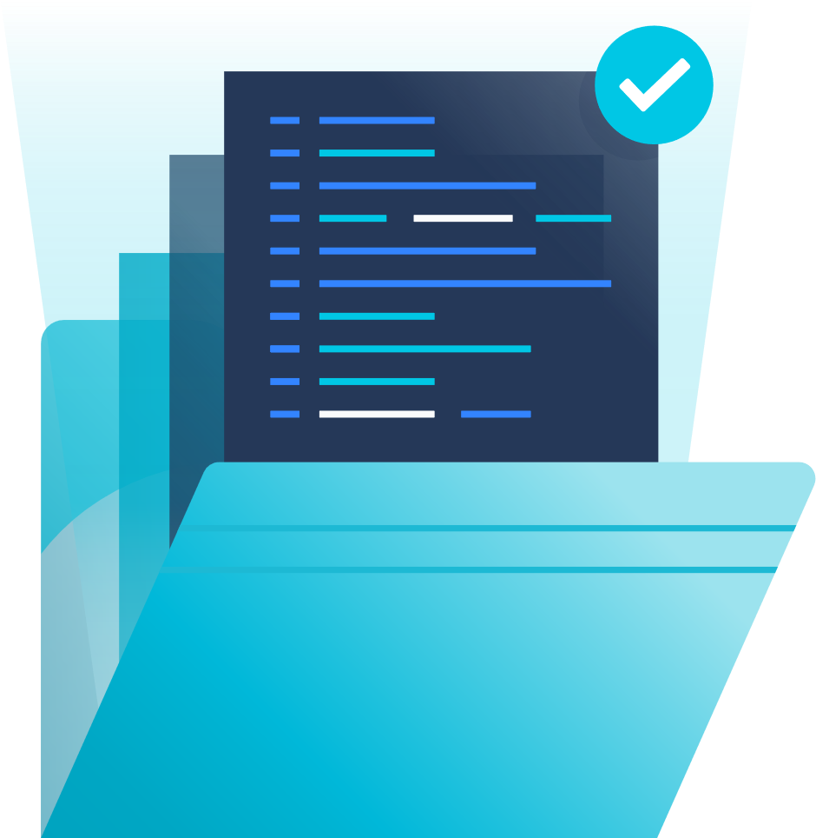
FEATURES
Manage
Merge Checks
Deployment Permissions
Notes:
Merge checks - Recommend specific conditions on merges for individual branches or branch patterns. Or enforce merge checks through Bitbucket Premium.
Deployment permissions - Configure controls on who can do deployments and from which branch. This is a Bitbucket Premium feature and can be accessed through Bitbucket Pipelines.

Slide 37

FEATURES
Launch
Bitbucket Pipes
Build Integrations
Notes:
Bitbucket Pipes - Plug-and-play to build and automate a CI/CD pipeline in Bitbucket Pipelines that meets your exact needs.
Build integrations - Bitbucket can show build results from your CI system. A simple pass or fail icon tells you about the health of your code.

Slide 38

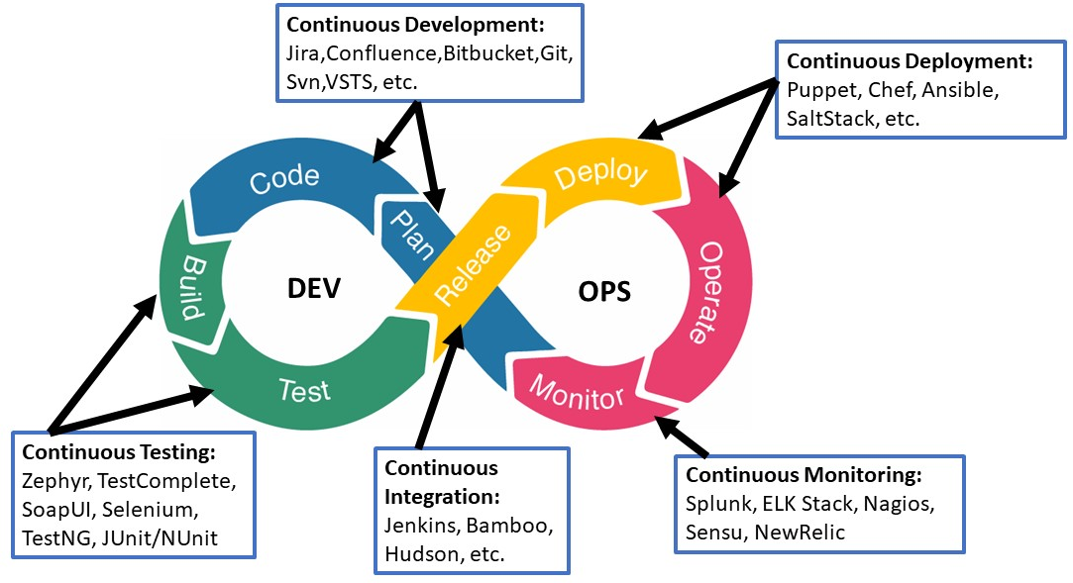
BITBUCKET
Integration to CI/CD Pipeline
Notes:
BitBucket Pipelines is a relatively similar product to Bamboo, Travis and Jenkins. It is built into the BitBucket system, (though you pay for more build minutes).
You can do many things such as:
running tests for Pull Requests
deploying code
scheduling tasks to run

Slide 39
Introduction of Jenkins

Slide 40
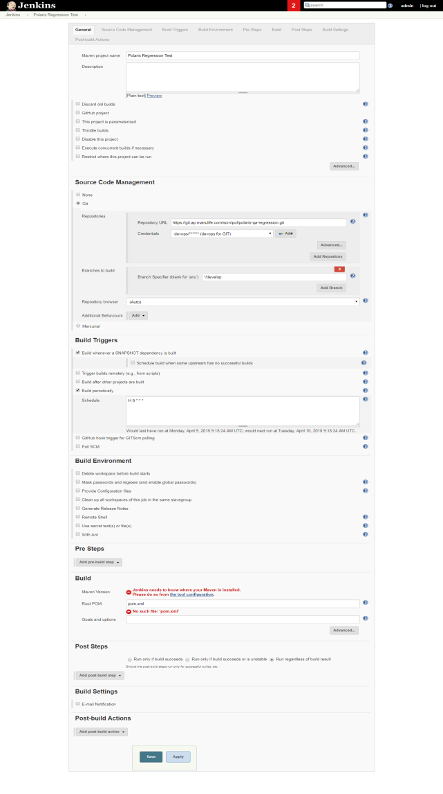
Jenkins Freestyle Project
“Freestyle project” is the currently supported pipeline type
Build Steps are configured via Jenkins web UI
Developers need to configure build, code scanning, deployment and notifications manually, according to technology stack of the software development project
Pipeline-as-code is under development, and will be provided to replace “Freestyle Project” pipeline type
Notes:
Jenkins is the core tool in the CI pipeline while it acts as kind of ‘manager’ to control all the process and flow of the pipeline. There are two ways to setup the pipelines on Jenkins: using a web based GUI and using a config file.
With the GUI, which we need to login to the Jenkins portal to access it, “Freestyle project” type is currently supported, we can setup the build steps & sequence with a web UI. All the steps is configured and customised according to the pipeline needs.
Let me show you how it looks
[Login to Jenkin and pick one configuration to showcase]

Slide 41
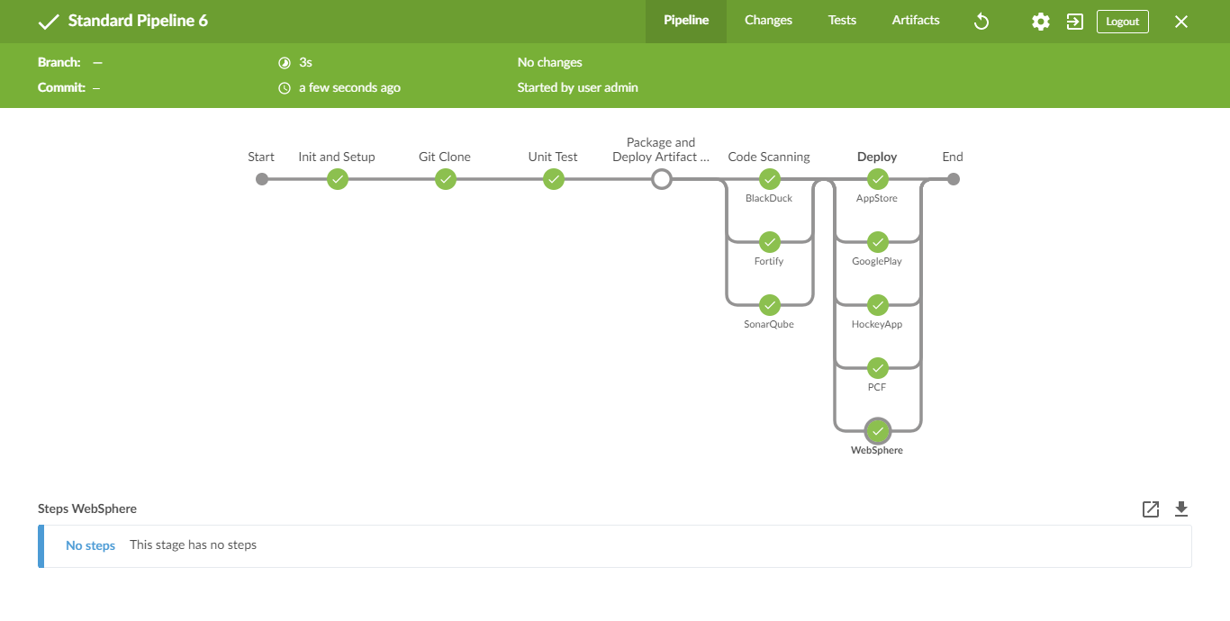
Pipeline as Code
Example Jenkinsfile pipeline {
agent any
stages {
stage('Build') {
steps {
sh 'make'
}
}
stage('Test'){
steps {
sh 'make check'
junit 'reports/**/*.xml'
}
}
stage('Deploy') {
steps {
sh 'make publish'
}
}
}
}
Standardize and enforce tasks to be run during pipeline executions
Pipeline can be customized using configuration file (Jenkinsfile)
Pipeline configuration to be version controlled and stored along with application source code
Will become the standardized method for defining and using pipeline, with predefined Pipeline Libraries for different technology stacks
Notes:
Another way of setting up the pipeline in Jenkins is the “Pipeline-as-code”, which is under development. This is a more developer-friendly way of setting up the pipeline using a configuration file called ‘Jenkinsfile”. Unlike the web GUI, the steps and sequences will all be set in Jenkinsfile, which is placed at the root of the source code folder.
The tasks in the files will be run during the pipeline execution. And this will be the standardized method for our pipeline creation in the future.

Slide 42
Introduction of SonarQube

Slide 43
What is SonarQube?
A free and open-source code quality platform
Continuous analyze of code quality by using static rules of code
Locate bugs, coding rules, test coverage, duplications, API documentation, complexity, and architecture
Learn to code better by showing you what is wrong and sub-optimal and provide guides to fix and improve

Slide 44
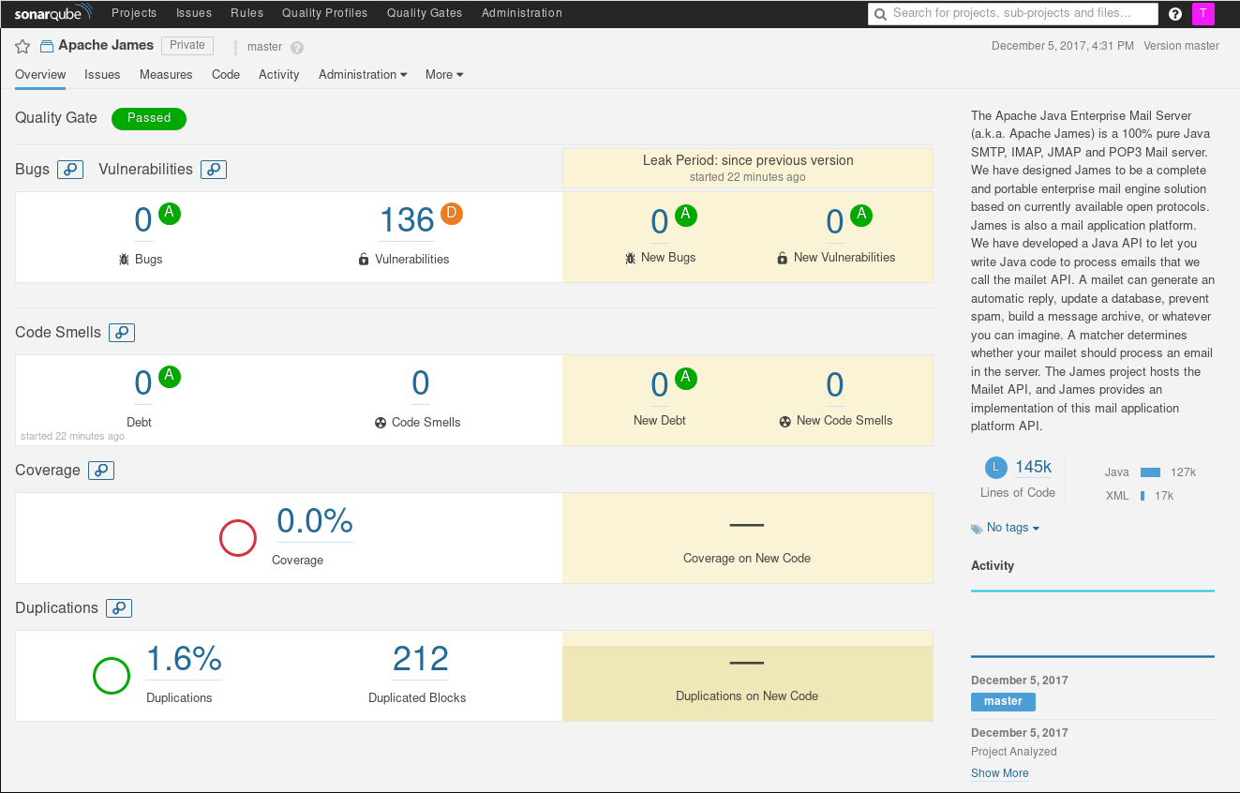
SonarQube User Interface
Notes:
Every scanned project can also be analyzed and acted for issues
Developers can monitor individual project dashboards to understand the quality metrics and fix reported issues
There are tabs which gives code quality information in various formats (source code lines, graphs, risk graphs, numbers, colors etc.)
Admin will have additional tab where configurations can be made to correct/upgrade the rules or quality gates.

Slide 45
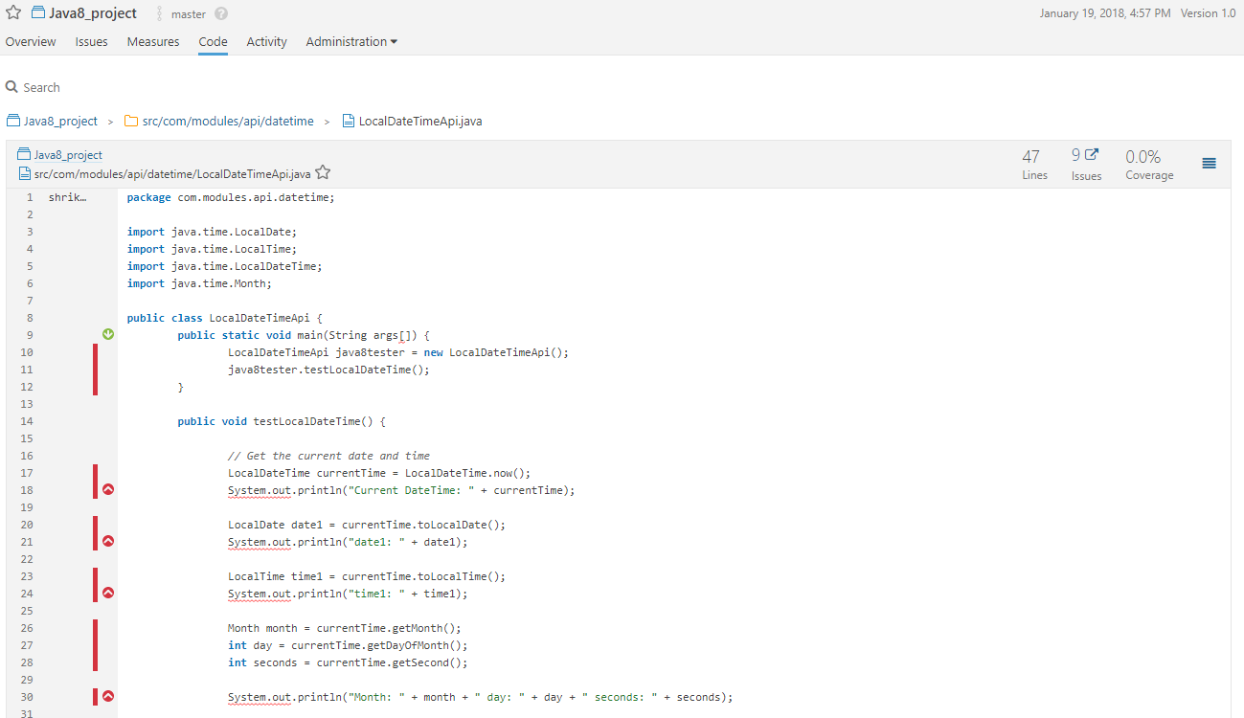
Using SonarQube
SonarQube Code Viewer
Notes:
Code Viewer feature of SonarQube is very important for developers to understand the issues in source code.
It displays source code with important statistics (colors, numbers etc.)
It helps to understand
Lines of code
Issues (bugs, vulnerabilities, Code Smells)
Duplications within the same file or in other files
SCM version history (it helps to understand who induced the problem)
Test coverage by unit tests
It can be accessed via
Measures tab under Project
Code tab under Project
Issues tab under Project
search utility at the top-right

Slide 46
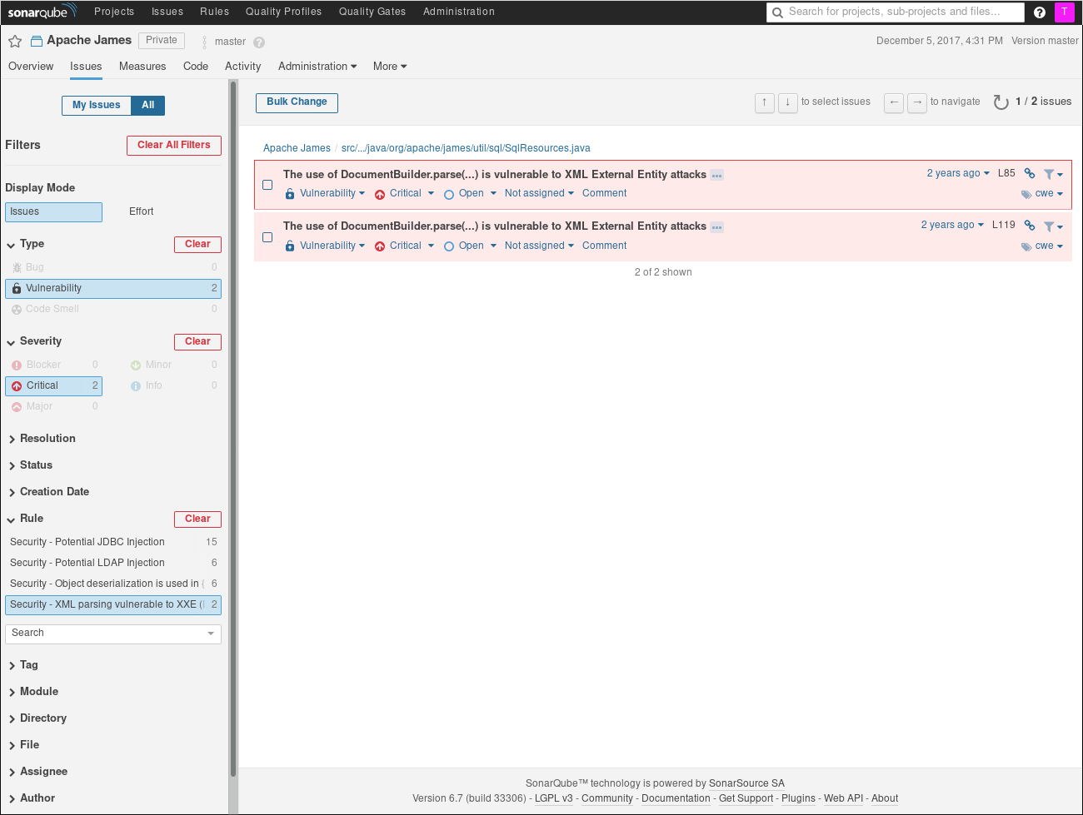
SonarQube User Interface

Slide 47
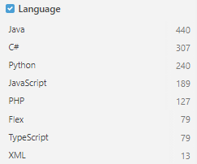
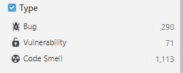
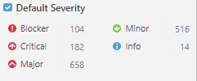
Using SonarQube
SonarQube Rules
Notes:
Around 1500 rules are available in default quality profile “Sonar way”. These rules can be seen with filter on Language or Type or Severity.
Admin can update the severity, add new rule or update existing rule as per need by project source code.
In SonarQube, analyzers contribute rules which are executed on source code to generate issues. There are four types of rules:
- Code Smell (Maintainability domain)
- Bug (Reliability domain)
- Vulnerability (Security domain)
- Security Hotspot (Security domain)
For Code Smells and Bugs, zero false-positives are expected. At least this is the target so that developers don't have to wonder if a fix is required.
For Vulnerabilities, the target is to have more than 80% of issues be true-positives.
Security Hotspot rules draw attention to code that is security-sensitive. It is expected that more than 80% of the issues will be quickly resolved as "Reviewed" after review by a developer.
The Rules page is the entry point where you can discover all the existing rules or create new ones based on provided templates.

Slide 48
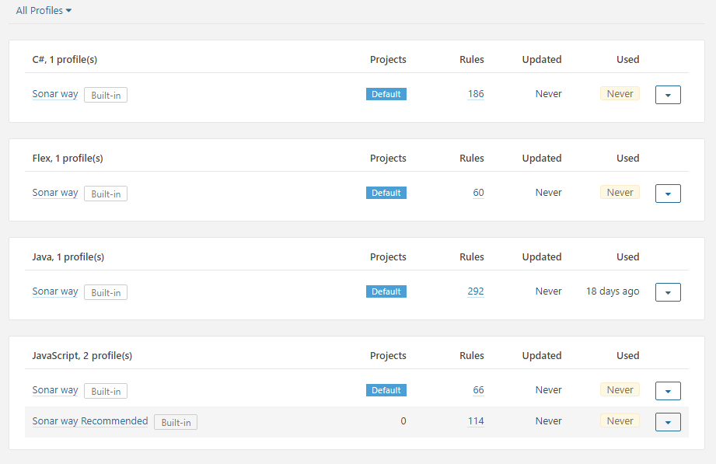
Using SonarQube
SonarQube Quality Profiles
Notes:
Quality Profiles are collections of rules to apply during the analysis of project source code.
For each language there is a default profile. All projects not explicitly assigned to some other profile will be analyzed with the default.
Admin can create new profile or restore backed up profile using create button on right side of the page.
For multiple languages, respective profiles are activated. Amount of rules configured in that profile can be seen on Quality Profile page.
Developer or admin can compare the profile with other profiles under same language.
Admin can mark other profile as default for the respective language.

Slide 49
Using SonarQube
SonarQube Issues
Issue Type:
Bug
Vulnerability
Code Smell
Notes:
While running an analysis, SonarQube raises an issue every time a piece of code breaks a coding rule. The set of coding rules is defined through the associated quality profile for each language in the project.
There are three types of issues:
Bug – A coding error that will break your code and needs to be fixed immediately.
Vulnerability – A point in your code that's open to attack.
Codesmell – A maintainability issue that makes your code confusing and difficult to maintain.

Slide 50
Using SonarQube
SonarQube Issues
Issue Severity
BLOCKER
Bug with a high probability to impact the behavior of the application in production: memory leak, unclosed JDBC connection etc.
The code MUST be immediately fixed.
CRITICAL
Either a bug with a low probability to impact the behavior of the application in production or an issue which represents a security flaw: empty catch block, SQL injection etc.
The code MUST be immediately reviewed.
MAJOR
Quality flaw which can highly impact the developer productivity: uncovered piece of code, duplicated blocks, unused parameters etc.
MINOR
Quality flaw which can slightly impact the developer productivity: lines should not be too long, "switch" statements should have at least 3 cases etc.
INFO
Neither a bug nor a quality flaw, just a finding.
Notes:
When source code is analyzed using SonarQube, it raises issues for line which breaks the configured rules. The rules are configured under quality profiles available for the project.

Slide 51
Using SonarQube
SonarQube Issues
Issues Lifecycle
STATUS
Open - set by SonarQube on new issues
Confirmed - set manually to indicate that the issue is valid
Resolved - set manually to indicate that the next analysis should Close the issue
Reopened - set automatically by SonarQube when a Resolved issue has not actually been corrected
Closed - set automatically by SonarQube for automatically created issues
Notes:
After creation, issues flow through a lifecycle, taking one of these five possible statuses.

Slide 52
Using SonarQube
SonarQube Key Measures Category
Category | Measures Descriptions | Must be fixed?
Security | Potential weaknesses to hackers. | All Blocker, Critical and Major security issues must be fixed
Reliability | Where the code behavior is other other than what was expected. | All Blocker, Critical and Major security issues must be fixed
Maintainability | Core is more difficult to update competently than it should. | All Blocker, Critical and Major security issues must be fixed For code smell, we should try the best to keep score as low as possible to make it easier to maintain
Notes:
After creation, issues flow through a lifecycle, taking one of these five possible statuses.

Slide 53
Using SonarQube
SonarQube Key Measures Category
Rules Category | Measures Descriptions | Must be fixed?
Coverage | The overall testing coverage in the code | Usually, the range is between 70%-90%. The higher the percentage means the more portion of code is covered by test cases. However, developers may need extra time to meet the higher coverage standard
Complexity | How simple or complicated the control flow of the application is. Cyclomatic Complexity measures the minimum number of test cases required for full test coverage. Cognitive Complexity is a measure of how difficult the application is to understand | The high cyclomatic scores means the logic is very complicated and includes lots of scenarios we needed to test. We should refactor the code is keep the logic simple and breakdown a complex logic into smaller pieces The high Cognitive score means it is very difficult to understand the code such as we include quite a number of if-else layers within if-else. Again, we should breakdown a complex logic into smaller pieces to allow other developers understand it easier
Notes:
After creation, issues flow through a lifecycle, taking one of these five possible statuses.

Slide 54
Using SonarQube
Common violations
Rules | Descriptions | Best Practice
Performance | logger.debug(“Debug message here” , a+b) ; Code performance will be impacted as even the logger level is not set to debug level, a+b is still executed. | We should use if(Logger.isDebugEnabled(){ logger.debug(“Debug message here”, a+b) }
Generic exceptions should never be thrown | Throw Exception() directly to caller when exception found public void foo(String bar) throws Throwable { throw new RuntimeException("My Message"); } | We should define a deliciated Exception instead throw Generic Exception to caller.
Replace System.out System.err by logger | Dump the message to output by System.out and System.err | We should use a logger to dump the message
Notes:
After creation, issues flow through a lifecycle, taking one of these five possible statuses.

Slide 55
Using SonarQube
Common violations
Rules | Descriptions | Best Practice
Cognitive Complexity of methods should not be too high | The flow control implemented within a method is very hard to understand | Break down the complexity flow control into smaller pieces / methods
Format specifiers should be used instead of string concatenation | Because printf-style format strings are interpreted at runtime, rather than validated by the compiler, they can contain errors that result in the wrong strings being created. This rule statically validates the correlation of printf-style format strings to their arguments when calling the format(...) methods of java.util.Formatter, java.lang.String, java.io.PrintStream, MessageFormat, and java.io.PrintWriter classes and the printf(...) methods of java.io.PrintStream or java.io.PrintWriter classes. | Use String.format to format the String ouput String foo= “foo”; String bar= “bar”; String.format("First %s and then %s", foo, bar); Instead String output = “First” + foo +” and then “ +bar;
Notes:
After creation, issues flow through a lifecycle, taking one of these five possible statuses.

Slide 56
Integrating SonarQube with Maven - Setup
Edit the settings.xml file, located in $MAVEN_HOME/conf or ~/.m2, to set the plugin prefix and optionally the SonarQube server URL.
<settings>
<pluginGroups>
<pluginGroup>org.sonarsource.scanner.maven</pluginGroup>
</pluginGroups>
<profiles>
<profile>
<id>sonar</id>
<activation>
<activeByDefault>true</activeByDefault>
</activation>
<properties>
<!-- Optional (default value is http://localhost:9000) -->
<sonar.host.url>http://yourserver:9000</sonar.host.url>
</properties>
</profile>
</profiles>
</settings>

Slide 57
Integrating SonarQube with Maven - Analyzing a Maven Project
This consists of running a Maven goal: sonar:sonar in the directory where the pom.xml file sits.
mvn clean verify sonar:sonar
In some situation you may want to run sonar:sonar goal as a dedicated step (use install as first step for multi-module projects):
mvn clean install
mvn sonar:sonar
Specify the version of sonar-maven-plugin instead of using the latest.
mvn org.sonarsource.scanner.maven:sonar-maven-plugin:3.4.1.1170:sonar

Slide 58
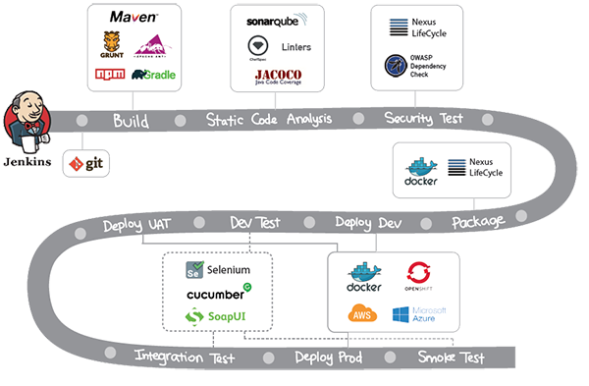
Sonarqube
Integration to CI/CD Pipeline
Notes:
Enhance Your Workflow – It let code quality boost your CI/CD, Non-disruptive code quality checks overlay your workflow and intelligently promote clean builds
Built-in Methodology – focus on new code
Overall health
Focus on the Leak
Enforce Quality Gate
Dig into issues
Highlight hot spots
Visualize the history of a project
Centralize Quality – it offers shared vision of code quality
All projects in one place
Shared rulesets
Unified Quality Gate
Cross projects services
Risk-based views
Parallel report processing

Slide 59
Exercise
Check in the sample code to git
Raise a merge request
Go to Jenkins to view the pipeline is triggered and execution status
Test the new app

Slide 60
Summary
DevOps Pipeline / Cycle
Source Code Management and GitFlow
Introduction of Jenkins
Introduction of SonarQube

Slide 61
References
Build Lifecycles
(https://maven.apache.org/guides/introduction/introduction-to-the-lifecycle.html)
Maven official site

